Slide 1
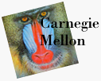
Ray Casting
Forward & Backward Ray Tracing
Ray Casting
Ray-Surface Intersection Testing
Barycentric Coordinates
11 Apr. 2000

Slide 2
Light is Bouncing Photons
Light sources send off photons in all directions
  Model these as particles that bounce off objects in the scene
  Each photon has a wavelength and energy (color and intensity)
  When photons bounce, some energy is absorbed, some reflected, some transmitted
If we can model photon bounces we can generate images
Technique: follow each photon from the light source until:
  All of its energy is absorbed (after too many bounces)
  It departs the known universe
  It strikes the image and its contribution is added to appropriate pixel

Slide 3
Forward Ray Tracing
Rays are the paths of these photons
This method of rendering by following photon paths is called ray tracing
Forward ray tracing follows the photon in direction that light travels (from the source)
BIG problem with this approach:
  Only a tiny fraction of rays will not reach the image
  Extremely slow
Ideal Scenario:
  we'd like to magically know which rays will eventually contribute to the image, and trace only those

Slide 4
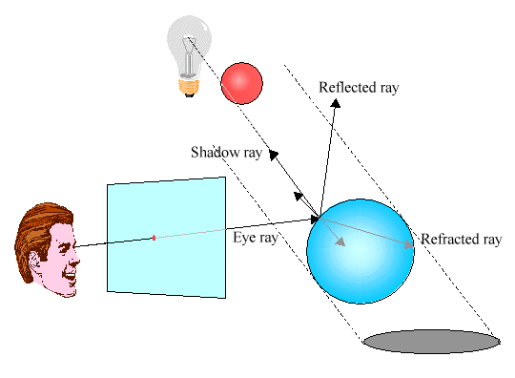
Backward Ray Tracing
The solution is to start from the image and trace backwards - backward ray tracing
  Start from the image and follow the ray until the ray finds (or fails to find) a light source
  People actually used to believe vision worked this way

Slide 5
Backward Ray Tracing
Basic ideas:
  Each pixel gets light from just one direction - the line through the image point and focal point
  Any photon contributing to that pixel’s color has to come from this direction
  So head in that direction and find what is sending light this way
  If we hit a light source - we’re done
  If we find nothing - we’re done
  If we hit a surface - see where that surface is lit from
At the end we’ve done forward ray tracing, but only for the rays that contribute to the image

Slide 6
Ray Casting
This version of ray tracing is often called ray casting
The algorithm is:
loop y
  loop x
    shoot ray from eye point through pixel (x,y) into scene
    intersect with all surfaces, find first one the ray hits
    shade that point to compute pixel (x,y)’s color
    (perhaps simulating shadows)
A ray is p+td: p is ray origin, d the direction
  t=0 at origin of ray, t>0 in positive direction of ray
  typically assume ||d||=1
  p and d are typically computed in world space
This is easily generalized to give recursive ray tracing...

Slide 7
Recursive Ray Tracing
We’ll distinguish four ray types:
  Eye rays: orginate at the eye
  Shadow rays: from surface point toward light source
  Reflection rays: from surface point in mirror direction
  Transmission rays: from surface point in refracted direction
Trace all of these recursively. More on this later.

Slide 8
Writing a Simple Ray Caster
Raycast() // generate a picture
  for each pixel x,y
    color(pixel) = Trace(ray_through_pixel(x,y))
Trace(ray) // fire a ray, return RGB radiance
// of light traveling backward along it
  object_point = Closest_intersection(ray)
  if object_point return Shade(object_point, ray)
  else return Background_Color
Closest_intersection(ray)
  for each surface in scene
  calc_intersection(ray, surface)
  return the closest point of intersection to viewer
  (also return other info about that point, e.g., surface normal, material properties, etc.)
Shade(point, ray) // return radiance of light leaving
// point in opposite of ray direction
  calculate surface normal vector
  use Phong illumination formula (or something similar)
  to calculate contributions of each light source

Slide 9
Ray-Surface Intersections
Ray equation: (given origin p and direction d)
  x(t) = p+td
Surfaces can be represented by:
  Implicit functions: f(x) = 0
  Parametric functions: x = g(u,v)
Compute Intersections:
  Substitute ray equation for x
  Find roots
  Implicit: f(p + td) = 0
    one equation in one unknown – univariate root finding
  Parametric: p + td - g(u,v) = 0
    three equations in three unknowns (t,u,v) – multivariate root finding
  For univariate polynomials, use closed form soln. otherwise use numerical root finder

Slide 10
The Devil’s in the Details
Solving these intersection equations can be tough...
  General case: non-linear root finding problem
  Simple surfaces can yield a closed-form solution
  But generally a numerical root-finding method is required
    Expensive to calculate
    Won’t always converge
    When repeated millions of times, errors WILL occur
The good news:
  Ray tracing is simplified using object-oriented techniques
    Implement one intersection method for each type of surface primitive
    Each surface handles its own intersection
  Some surfaces yield closed form solutions:
    quadrics: spheres, cylinders, cones, elipsoids, etc…)
    polygons
    tori, superquadrics, low-order spline surface patches

Slide 11
Ray-Sphere Intersection
Ray-sphere intersection is an easy case
A sphere’s implicit function is: x²+y²+z²-r²=0 if sphere at origin
The ray equation is: x = p_{x}+td_{x}
        y = p_{y}+td_{y}
        z = p_{z}+td_{z}
Substitution gives: (p_{x}+td_{x})² + (p_{y}+td_{y})² + (p_{z}+td_{z})² - r² = 0
A quadratic equation in t.
Solve the standard way: A = d_{x}²+d_{y}²+d_{z}² = 1 (unit vec.)
        B = 2(p_{x}d_{x}+p_{y}d_{y}+p_{z}d_{z} )
        C = p_{x}²+p_{y}²+p_{z}² - r²
Quadratic formula has two roots: t=(-B±sqrt(B²-4C))/2
  which correspond to the two intersection points
  negative discriminant means ray misses sphere
At²+Bt+C=0

Slide 12
Ray-Polygon Intersection
Assuming we have a planar polygon
  first, find intersection point of ray with plane
  then check if that point is inside the polygon
Latter step is a point-in-polygon test in 3-D:
  inputs: a point x in 3-D and the vertices of a polygon in 3-D
  output: INSIDE or OUTSIDE
  problem can be reduced to point-in-polygon test in 2-D
Point-in-polygon test in 2-D:
  easiest for triangles
  easy for convex n-gons
  harder for concave polygons
  most common approach: subdivide all polygons into triangles
  for optimization tips, see article by Haines in the book Graphics Gems IV

Slide 13
Ray-Plane Intersection
Ray: x=p+td
  where p is ray origin, d is ray direction. we’ll assume ||d||=1 (this simplifies the algebra later)
  x=(x,y,z) is point on ray if t>0
Plane: (x-q)•n=0
  where q is reference point on plane, n is plane normal. (some might assume ||n||=1; we won’t)
  x is point on plane
  if what you’re given is vertices of a polygon
    compute n with cross product of two (non-parallel) edges
    use one of the vertices for q
  rewrite plane equation as x•n+D=0
    equivalent to the familiar formula Ax+By+Cz+D=0, where (A,B,C)=n, D=-q•n
    fewer values to store
Steps:
  substitute ray formula into plane eqn, yielding 1 equation in 1 unknown (t).
  solution: t = -(p•n+D)/(d•n)
    note: if d•n=0 then ray and plane are parallel - REJECT
    note: if t<0 then intersection with plane is behind ray origin - REJECT
  compute t, plug it into ray equation to compute point x on plane

Slide 14
Projecting A Polygon from 3-D to 2-D
Point-in-polygon testing is simpler and faster if we do it in 2-D
  The simplest projections to compute are to the xy, yz, or zx planes
  If the polygon has plane equation Ax+By+Cz+D=0, then
    |A| is proportional to projection of polygon in yz plane
    |B| is proportional to projection of polygon in zx plane
    |C| is proportional to projection of polygon in xy plane
    Example: the plane z=3 has (A,B,C,D)=(0,0,1,-3), so |C| is the largest and xy projection is best. We should do point-in-polygon testing using x and y coords.
  In other words, project into the plane for which the perpendicular component of the normal vector n is largest
Optimization:
  We should optimize the inner loop (ray-triangle intersection testing) as much as possible
  We can determine which plane to project to, for each triangle, as a preprocess

Slide 15
Interpolated Shading for Ray Tracing
Suppose we know colors or normals at vertices
  How do we compute the color/normal of a specified point inside?
Color depends on distance to each vertex
  Want this to be linear (so we get same answer as scanline algorithm such as Gouraud or Phong shading)
  But how to do linear interpolation between 3 points?
  Answer: barycentric coordinates
Useful for ray-triangle intersection testing too!

Slide 16






Barycentric Coordinates in 1-D
Linear interpolation between colors C₀ and C₁ by t
We can rewrite this as
Geometric intuition:
  We are weighting each vertex by ratio of distances (or areas)
α and β are called barycentric coordinates

Slide 17



Barycentric Coordinates in 2-D
Now suppose we have 3 points instead of 2
Define three barycentric coordinates: α, β, γ
How to define α, β, and γ ?

Slide 18

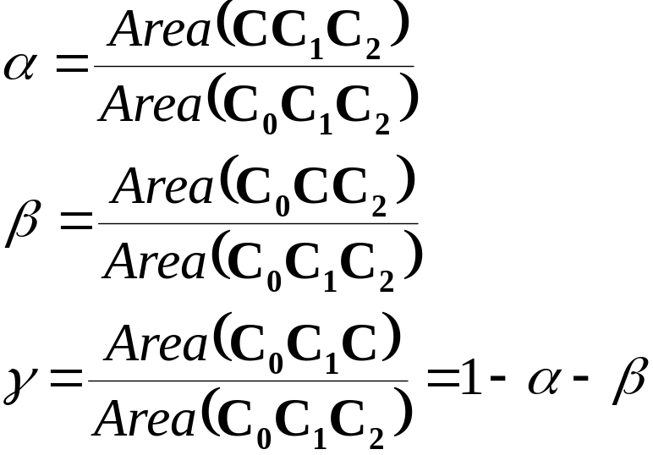



Barycentric Coordinates for a Triangle
Define barycentric coordinates to be ratios of triangle areas

Slide 19
Computing Area of a Triangle
in 3-D
  Area(ABC) = parallelogram area / 2 = ||(B-A) x (C-A)||/2
  faster: project to xy, yz, or zx, use 2D formula
in 2-D
  Area(xy-projection(ABC)) = [(b_{x}-a_{x})(c_{y}-a_{y}) – (c_{x}-a_{x})(b_{y}-a_{y})]/2
    project A,B,C to xy plane, take z component of cross product
  positive if ABC is CCW (counterclockwise)
C
A
B

Slide 20
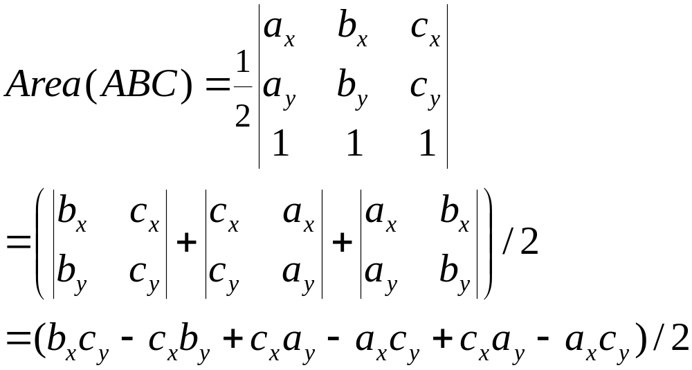
Computing Area of a Triangle - Algebra
That short formula,
  Area(ABC) = [(b_{x}-a_{x})(c_{y}-a_{y}) – (c_{x}-a_{x})(b_{y}-a_{y})]/2
Where did it come from?
c_{y}
a_{y}
b_{y}
a_{x}
b_{x}
c_{x}
The short & long formulas above agree.
Short formula better because fewer multiplies. Speed is important!
Can we explain the formulas geometrically?

Slide 21
Computing Area of a Triangle - Geometry
Area(ABC) =[(b_{x}-a_{x})(c_{y}-a_{y}) – (c_{x}-a_{x})(b_{y}-a_{y})]/2
  is a sum of rectangle areas, divided by 2.
(b_{x}-a_{x})(c_{y}-a_{y})
(c_{x}-a_{x})(a_{y}-b_{y})
[
]
c_{y}
?
+
/2 =
/2 =
a_{y}
b_{y}
a_{x}
b_{x}
c_{x}
c_{y}
!
!
a_{y}
/2 =
=
=
b_{y}
a_{x}
b_{x}
c_{x}
since triangle area = base*height/2
it works!

Slide 22




Uses for Barycentric Coordinates
Point-in-triangle testing!
  point is in triangle iff α, β, γ > 0
  note similarity to standard point-in-polygon methods that use tests of form a_{i}x+b_{i}y+c_{i}<0 for each edge i
Can use barycentric coordinates to interpolate any quantity
  Gouraud Shading (color interpolation)
  Phong Shading (normal interpolation)
  Texture mapping ((s,t) texture coordinate interpolation)

